Slide 1
Workstation Installation
Configuring Your Laptop as a Workstation

Slide 2
Objectives
After completing this module, you should be able to
Ensure that ChefDK is installed on your laptop
Execute a series of commands to ensure everything is installed
Download a repository of cookbooks
Install a local editor like Atom
Notes:
We have been doing a lot of great work with Chef on this remote workstation that we have provided for you.
In this section we will walk through the installation of the necessary tools and the commands to verify your installation.

Slide 3
Installing the ChefDK
Installing the tools on your system
Install the ChefDK
Open a Terminal / Command Prompt
Execute a series of commands to ensure everything is installed
Download a repository of cookbooks
Install git (optional)
Install a text editor (optional)
Notes:
To become a successful Chef developer, you will want to install Chef tools on your local workstation. These tools are available in the Chef Development Kit (ChefDK). After the installation is complete, we will verify that the various tools are working.
Then we will download a copy of the cookbooks that we created together.
After that you can optionally download a number of other tools that will help you in your journey using Chef. The first is git and the second is a text editor.
Let's get started.

Slide 4
ChefDK
The ChefDK contains tools like chef-apply, chef-client, and kitchen.
You can find the ChefDK to download at the website downloads.chef.io. Be sure to download ChefDK version 0.8.1
https://downloads.chef.io/chef-dk/
Notes:
Throughout this course we have been using a number of tools found within the ChefDK. The ChefDK contains tools like 'chef-apply', 'chef-client', and 'kitchen'. It also has a number of other great tools that we will use when connecting to a Chef Server, managing cookbook dependencies, or ensuring the quality of the cookbooks that we write.
You can download the ChefDK at https://downloads.chef.io/chef-dk.
Instructor Note: Prior to attending this course they may have received correspondence that informed them to setup the ChefDK on their systems. It is possible that they did not and this slides acts as a good reminder to ensure that they have the necessary tools before continuing on to the next section. IMPORTANT: This course requires ChefDK version 0.8.1. If you use a later version such as 0.9.0, the exercises and labs won’t work properly.

Slide 5
GE: Download the ChefDK
ChefDK is a tool chain built on top of the Ruby programming language.
The ChefDK installer does not install any particular graphical-user-interface—installs CLI instead
https://downloads.chef.io/chef-dk/
Notes:
The ChefDK is a tool chain built on top of the Ruby programming language. To assist with making the tools more portable to all platforms we package Ruby and all these tools together in a single platform specific installation package.
The installer does not install any particular graphical user interface, GUI, but instead installs the command-line tools we have been using thus far.
You may have already downloaded the ChefDK previously in this course.

Slide 6
GE: Installing ChefDK
The omnibus installer is used to set up the Chef development kit on a workstation, including the chef-client itself, an embedded version of Ruby, RubyGems, OpenSSL, key-value stores, parsers, libraries, command line utilities, and community tools such as Kitchen, Berkshelf, and ChefSpec.
https://downloads.chef.io/chef-dk/
Notes:
Instructor Note: They should install the ChefDK locally here.

Slide 7
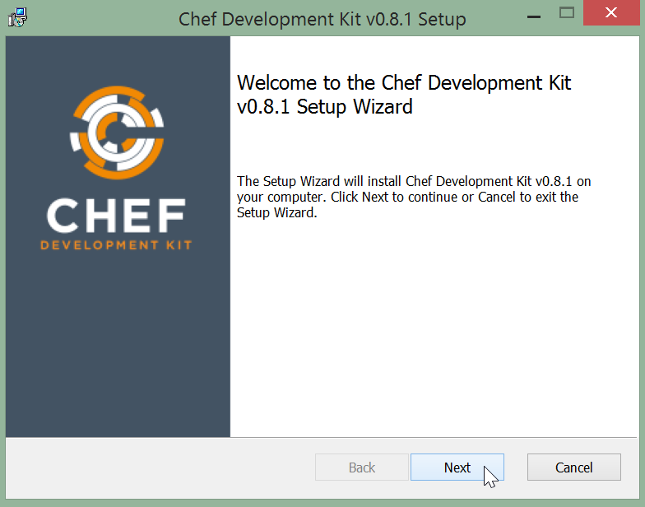
GE: Installing ChefDK
Notes:
Follow the ChefDK installation wizard's instructions. It could take over 10 minutes to install ChefDK.
ChefDk will be installed into an opscode folder on your laptop.

Slide 8
Lab: Run All These Commands
$ chef --version
$ chef-client --version
$ knife --version
$ ohai --version
$ berks --version
$ kitchen --version
$ foodcritic --version
$ rubocop --version
Notes:
Open a local command prompt or something like Windows Power Shell if you prefer and then run these commands.
Some of these commands, like 'chef', 'chef-client', 'ohai', and 'kitchen', are the ones that we have used on our remote workstation. Some of these commands you have not seen yet. Later in this course, we'll explore the commands 'knife' and 'berks'. Some of the remaining commands, like 'foodcritic' and 'rubocop', verify the quality of our cookbook code but will not be discussed in the next sections.
All of these commands have the ability to report their versions. This ensures that all the commands are installed properly on your execution path. If any of these commands fail to run this is the time to stop and troubleshoot them.

Slide 9
git
Git was initially designed and developed by Linus Torvalds for Linux kernel development in 2005, and has since become the most widely adopted version control system for software development.
http://git-scm.com/downloads
Notes:
We used git on the remote workstations. Chef and the Chef community uses git to manage the source code that we write. It is not required that you install git or use git when working with source code. However, we strongly recommend you use a version control tool and if you have not selected one then please install and use git. It's great once you get through the learning curve.
Instructor Note: It is not necessary that the learner install git. In some situations they may not be even allowed to install it. This again may be a good point to remind them that working with Chef and the Chef community they will likely come in contact with git again and so it is useful to have this tool to be able to participate in reading the source code and contributing fixes, changes, and features.

Slide 10
Text Editors
When working with Chef you spend a large time editing files.
Whatever editor you use should optimize for this workflow.
Notes:
As you have experienced during this introduction to working with Chef, a lot of what you are doing is writing source code in an editor. To work with Chef, you spend a large amount of time editing files, saving your work, and then opening more files. Whatever editor you use should optimize for this workflow.
A large number of basic editors that come standard on your operating system are capable of working with chef: notepad; textedit; kedit; etc. However, they are not always optimized for this workflow.

Slide 11
ATOM Editor
Atom is modern, approachable, and hackable to the core. We can't wait to see what you build with it.
https://atom.io
Notes:
The Atom editor tool can be customized to do anything, but can also be used productively on the first day without ever touching a config file. Atom is modern, approachable, and hackable to the core. We can't wait to see what you build with it.
You can download Atom at this time, if you don't already have it. You could also use Sublime Text if you already have it.

